Slide 1

Phishing detection
Submitted by;
Ahalya suraj (e6221021)
Athulkrishna t.s(e5221024)

Slide 2
Contents:
Introduction to phising
Data preprocessing
Eda (exploratory data analysis)
Visualization
Applying machine learning alogrithms

Slide 3
What is phishing?
Phishing (pronounced: fishing) is an attack that attempts to steal your money, or your identity, by getting you to reveal personal information -- such as credit card numbers, bank information, or passwords -- on websites that pretend to be legitimate.
It occurs when an attacker, masquerading as a trusted entity, dupes a victim into opening an email, instant message, or text message.

Slide 4
Different types of phishing:
There are four types of phishing ,they are:
Spear Phishing.
Whaling.
Vishing.
Email Phishing.

Slide 5
Data preprocessing

Slide 6
Data preprocessing contains: loading the dataset identifying the null values etc.
For data preprocessing we use pandas and numpy.
Loading the dataset
The dataset used here is phising dataset we call or load it using read_csv if it is a csv file.
So here we use pandas as pd to load the file.

Slide 7
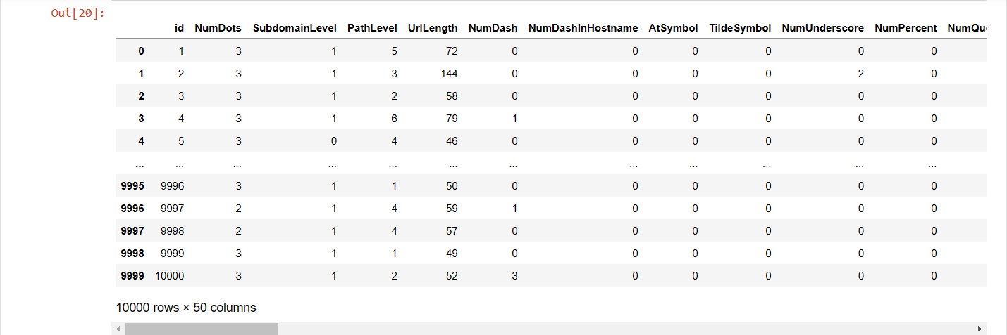

Slide 8
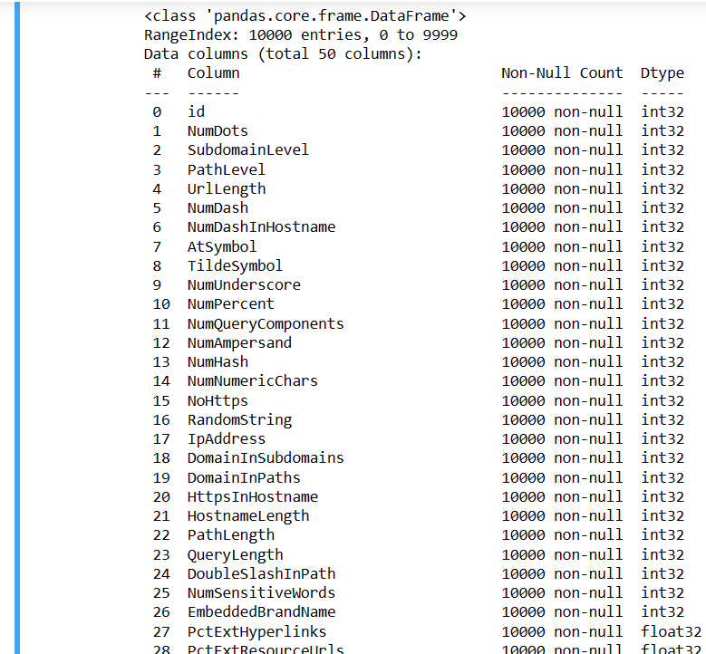
Handling the null value and info: when we took the info() we came to know the full information that we needed to know about the dataset.

Slide 9
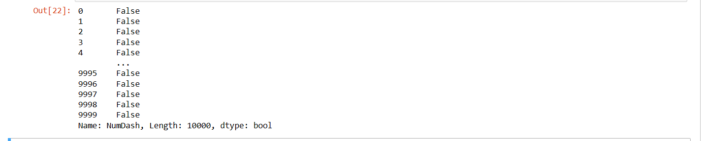
Searching for a null value in a particular column
Here we checked the null value for the column 'NumDash'.
After applying the isnull() we came to know that there are no null values present in the column.
So with the previous process we are also clear that the full dataset is not having any null value.

Slide 10
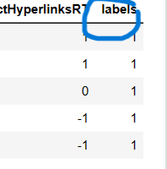
Renaming a particular column:
Rename() is used to rename an existing column name to a new name
Here we took a column name 'column label' and renamed it as labels

Slide 11
EDA(Exploratory Data Analysis)

Slide 12
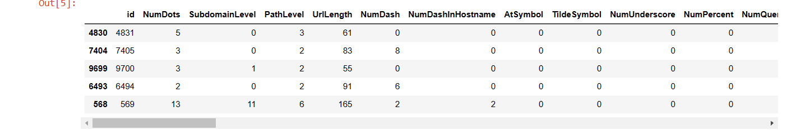
Taking the sample of the dataset
Sample() is used to take a sample of the dataset.
Here we used sample(5) so we get 5 rows and all the columns as the o/p.

Slide 13
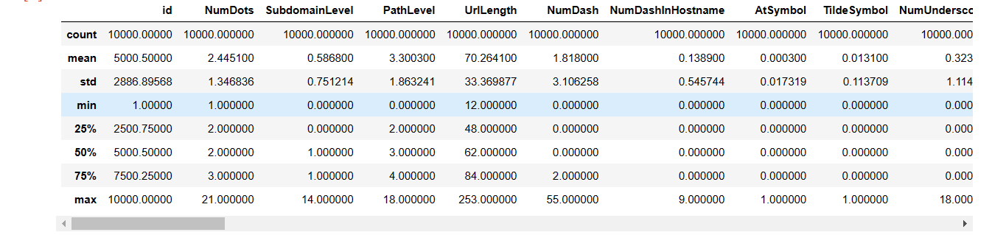
Describing the dataset describe() is used to describe the data by showing no of columns and rows etc.

Slide 14
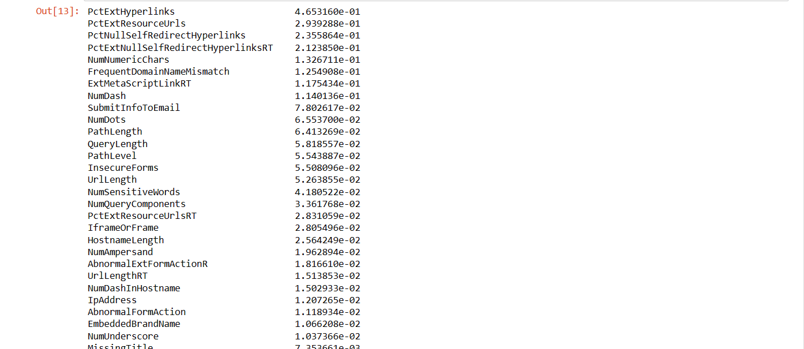
Sorting values
from sklearn.feature_selection import mutual_info_classif
This the package we have imported for the sorting and taking the info for patricular column.

Slide 15
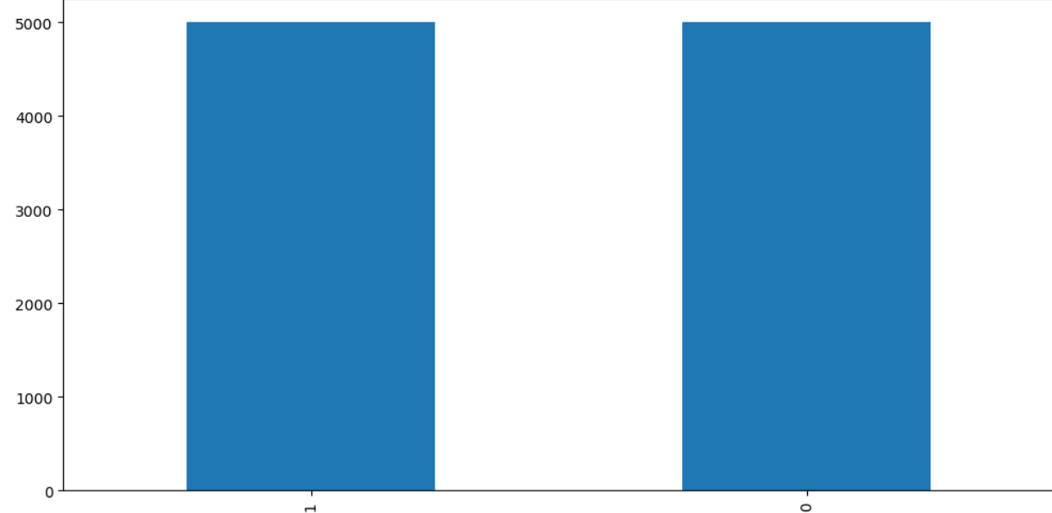
Visualization
Bar graph
Here we imported pandas ,matplotlib.pyplot as plt
We created this plot wrt labels column and values_count which is the total count of the values.
And we have specified while writing the code the function bar.

Slide 16
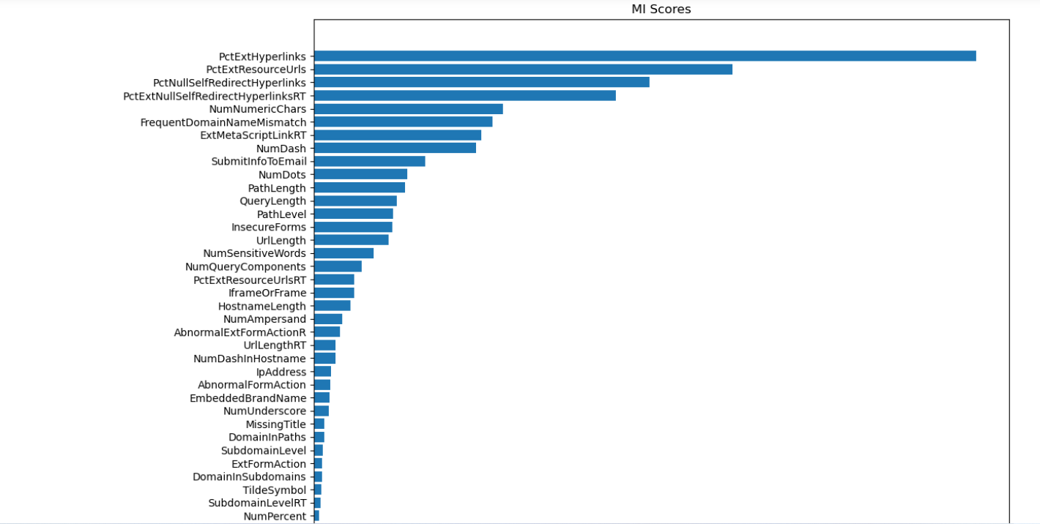
Visualization by using sort function
Horizontal bar graph
The column used here are mi_scores (the column that we sorted and kept previously) and length or x value would be unsorted value of the same column.
Here we use barh().

Slide 17
Applying the machine learning algorithms

Slide 18
Machine learning algorithms
The three machine learning algorithms used here are:
Decision tree
Logistic regression
Naïve bayes

Slide 19

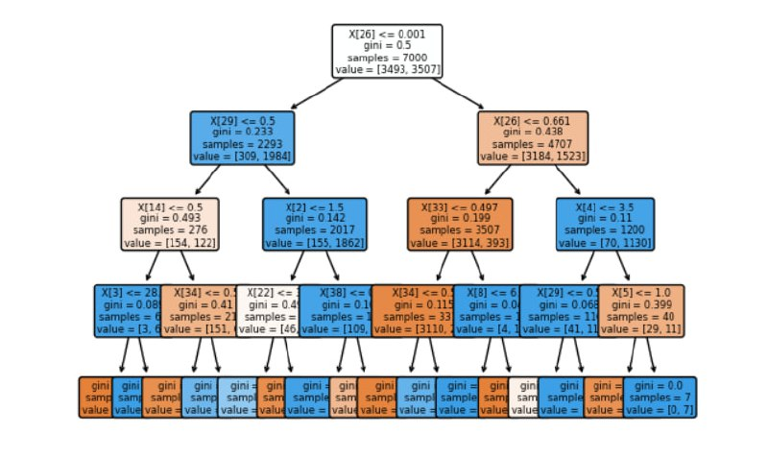
Decision tree
Decision Tree is the most powerful and popular tool for classification and prediction. A Decision tree is a flowchart-like tree structure, where each internal node denotes a test on an attribute, each branch represents an outcome of the test, and each leaf node (terminal node) holds a class label. accuracy

Slide 20
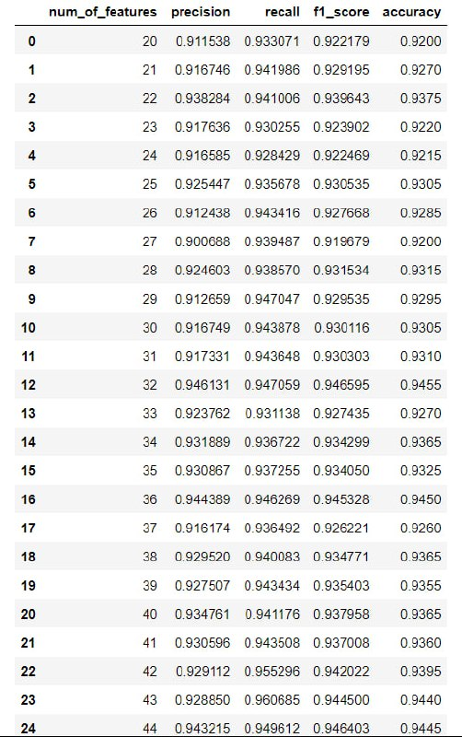
Logistic regression
Logistic regression estimates the probability of an event occurring, such as voted or didn't vote, based on a given dataset of independent variables. Since the outcome is a probability, the dependent variable is bounded between 0 and 1.

Slide 21

Naïve bayes
Naïve Bayes is one of the fast and easy ML algorithms to predict a class of datasets. It can be used for Binary as well as Multi-class Classifications. It performs well in Multi-class predictions as compared to the other Algorithms. It is the most popular choice for text classification problems.
Confusion matrix Accuracy

Slide 22
Correlation

Slide 23
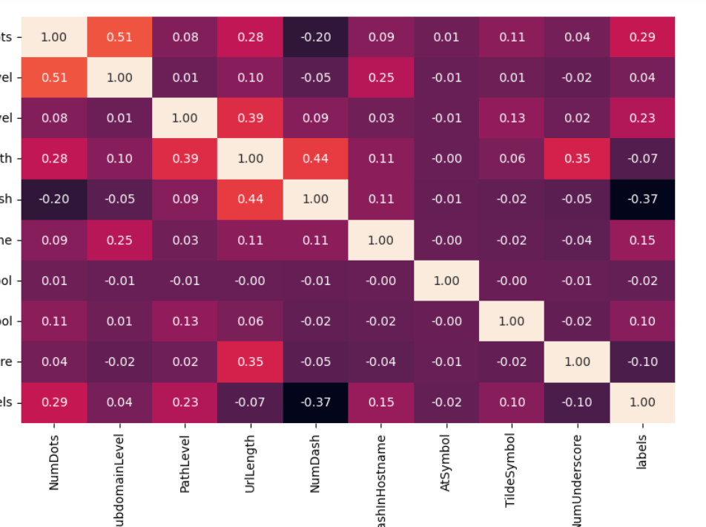
Correlation for 10 values
def corr_heatmap
Used columns:y=labels

Slide 24
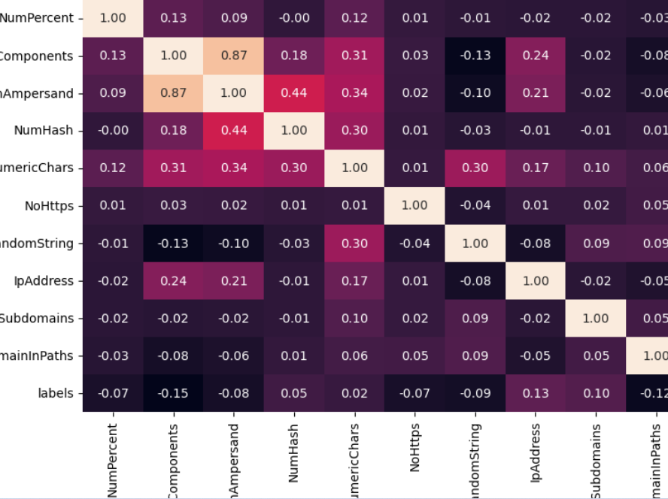
Correlation for (10,20) values
def corr_heatmap
Used columns:y=labels

Slide 25

This Photo by Unknown author is licensed under CC BY-SA.

Slide 26
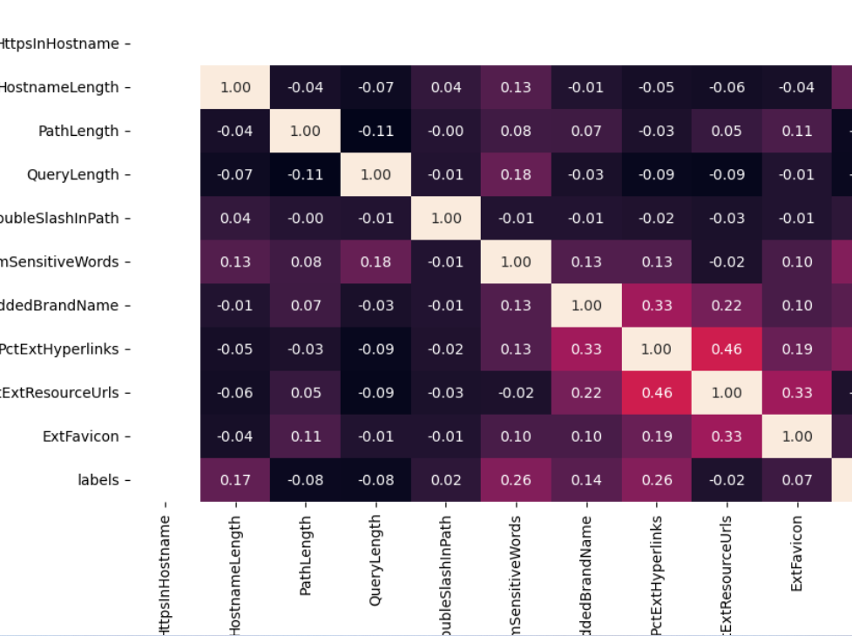
Correlation for (20,30) values
def corr_heatmap
Used columns:y=labels

